Slide 1
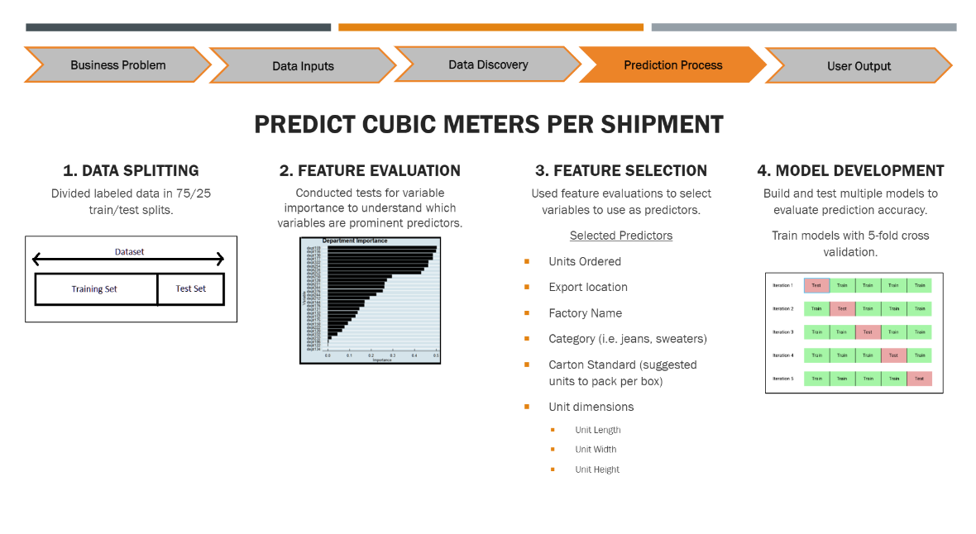
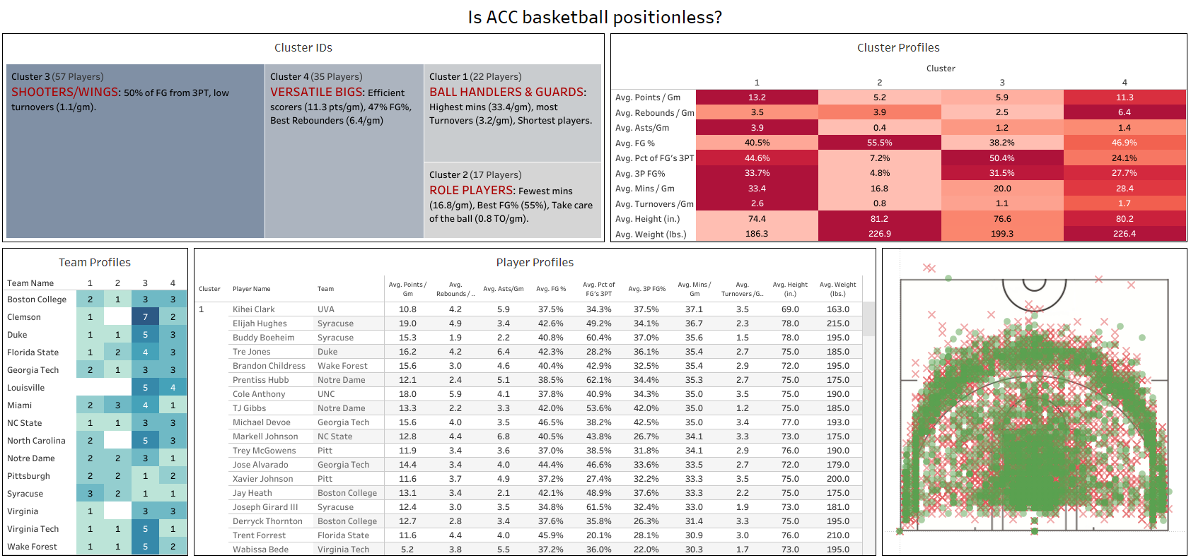
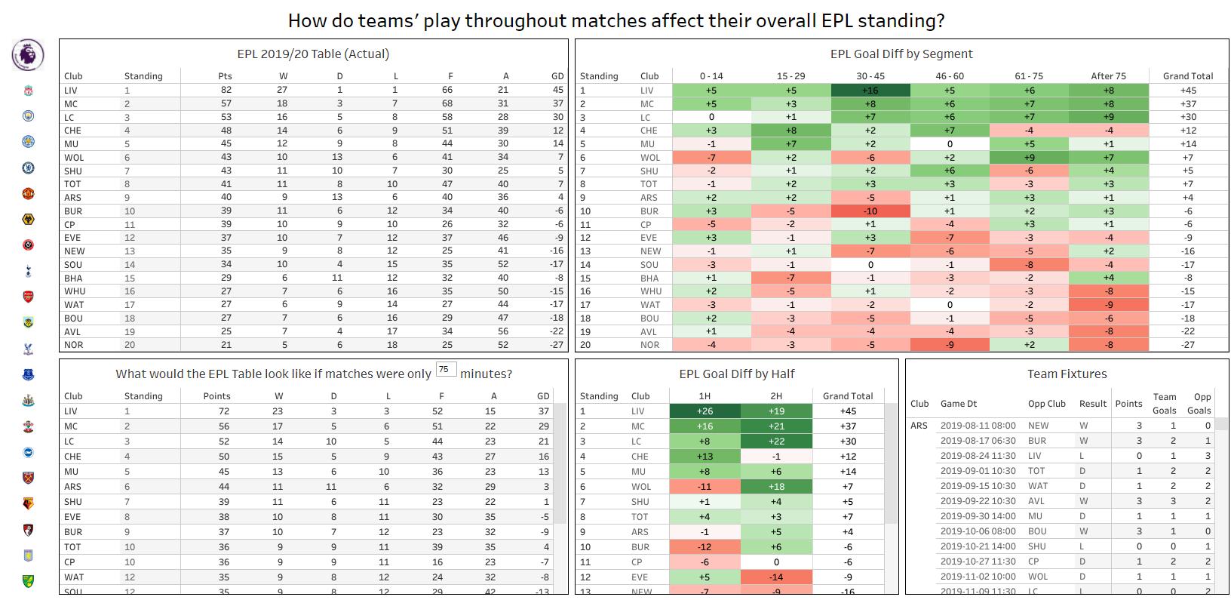
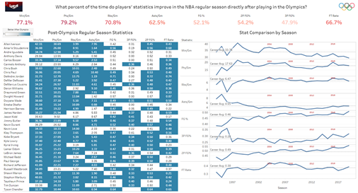
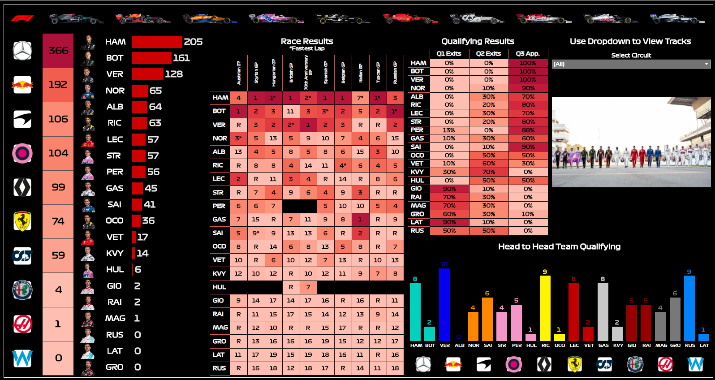
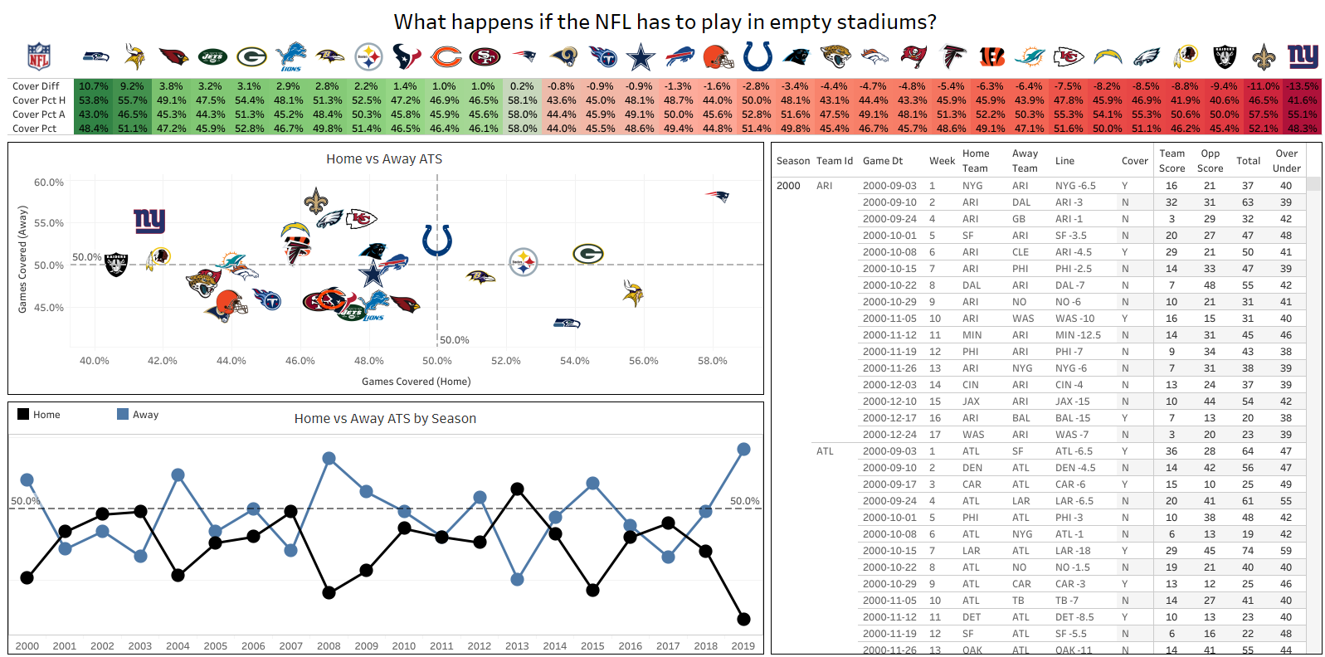
JM Repositories
Github
Tableau Public
Click images to view dashboards.
joshdmark@gmail.com
Josh Mark Work Samples
Supervised Machine Learning
How can we accurately predict the number of ocean containers required for shipment?
Tools: Decision Trees, Regression, Outlier Detection
Thesis Paper Overview Ppt
Unsupervised Machine Learning
Are the 5 basketball positions outdated? A clustering exercise to find out.
Tools: K-Means clustering, tidyverse data cleaning
Summary Article R Code
Simulation
What if English Premier League matches were only 75 mins? How would the standings differ?
Tools: Scenario Analysis, For loops, SQL
R Code
Descriptive Analytics
Does playing in the Olympics help NBA players? A look at player statistics after the Olympics.
R Code
Data Visualization
Dashboard for team & driver performance during the 2020 Formula 1 season.
R Code
Descriptive Analytics
If fans aren’t allowed at NFL games, which teams benefit the most, or least?
R Code

